Slide 1
Managing Software Quality
Main issues:
Quality cannot be added as an afterthought
To measure is to know
Product quality vs process quality
Notes:
© SE, Quality, Hans van Vliet

Slide 2
Features of Quality Software
Several classifications, with different degrees of abstraction: Most abstractly:
Quality Software Meets the needs of its users Is reliable (does not fail) Is easy to maintain (correct, or change).
SE, Quality, Hans van Vliet, ©2008

Slide 3
F.U.R.P.S
Functionality: functions it performs, their generality and security
Usability: aesthetics, consistency, documentation Reliability: frequency and severity of failure, accuracy of output
Performance: response time, resource consumption
Supportability: can it be extended, adapted, corrected?
SE, Quality, Hans van Vliet, ©2008

Slide 4
Software Quality Factors - I
At the finest level of detail:
Correctness - the extent to which the software satisfies its specification and fulfils customer objectives
Reliability - the extent to which the system performs without malfunctions
Efficiency - the amount of computer resources required to perform its functions.
SE, Quality, Hans van Vliet, ©2008

Slide 5
Software Quality Factors - II
Integrity - the extent to which access to functions and data can be controlled
Usability - the effort required to learn, operate, prepare input for and interpret output from, the software
Maintainability - the effort required to locate and fix errors in operative software
Testability - the effort required to ensure that the software performs its intended functions.
SE, Quality, Hans van Vliet, ©2008

Slide 6
Software Quality Factors - III
Flexibility - the effort required to modify operational software
Portability - the effort required to transfer software from one hardware configuration and/or software environment to another
Re-usability - the extent to which software can be used in applications other that that for which it was produced
Adaptability - the effort required to couple one system with another
SE, Quality, Hans van Vliet, ©2008

Slide 7
Examples of good quality
Easy to change the UI language of the application (English, French, Italian or Chinese)
Easy to re-use code, classes on new project
Easy to plug in new credit card, payment providers
Will no accept invalid data
SE, Quality, Hans van Vliet, ©2008

Slide 8

Commitment to quality pays off
SE, Quality, Hans van Vliet, ©2008
Notes:
© SE, Quality, Hans van Vliet

Slide 9
Change Control Any change can introduce errors
It is important to have a change control process
To keep a version before the changes, so they can be rolled-back if necessary
To incorporate a change once it is made satisfactorily
So that simultaneous changes do not conflict.
SE, Quality, Hans van Vliet, ©2008

Slide 10
Approaches to quality
Quality of the product versus quality of the process
Check whether (product or process) conforms to certain norms
Improve quality by improving the product or process
SE, Quality, Hans van Vliet, ©2008

Slide 11
Approaches to quality
Conformance
Improvement
Product
ISO 9126
‘best practices’
CMM
SPICE
Bootstap
ISO 9001
SQA
Process
SE, Quality, Hans van Vliet, ©2008

Slide 12


What is quality?
+
software
measures
SE, Quality, Hans van Vliet, ©2008

Slide 13
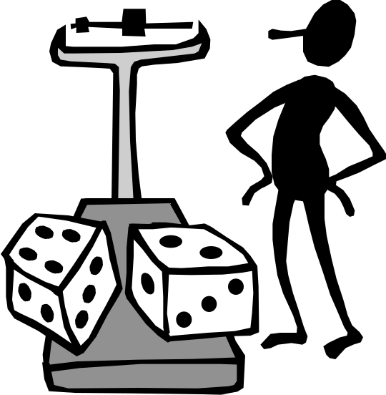
How to measure “complexity”?
The length of the program?
The number of goto’s?
The number of if-statements?
The sum of these numbers?
Yet something else?
SE, Quality, Hans van Vliet, ©2008

Slide 14
A measurement framework
Formal world
“Real” world
scale type
belongs to
unit
entity
holds for
expressed in
has
measures
value
attribute
computes
used in
part of
formalizes
attribute-relation model
attribute relation
SE, Quality, Hans van Vliet, ©2008

Slide 15

Scale types
Nominal: just classification
Ordinal: linear ordering (>)
Interval: like ordinal, but interval between values is the same (so average has a meaning)
Ratio: like interval, but there is a 0 (zero) (so A can be twice B)
Absolute: counting number of occurrences
SE, Quality, Hans van Vliet, ©2008

Slide 16
Representation condition
A measure M is valid if it satisfies the representation condition, i.e. if A>B in the real world, then M(A)>M(B)
E.g. if we measure complexity as the number of if-statements, then:
  Two programs with the same number of if-statements are equally complex
  If program A has more if-statements than program B, then A is more complex than B
SE, Quality, Hans van Vliet, ©2008

Slide 17
More on measures
Direct versus indirect measures
Internal versus external attributes
  External attributes can only be measured indirectly
  Most quality attributes are external
Scale type of a combined measure is the ‘weakest’ of the scale types of its constituents
  This is often violated; see cost estimation models
SE, Quality, Hans van Vliet, ©2008

Slide 18
Quality attributes (McCall)
Product operation
  Correctness does it do what I want?
  Reliability does it do it accurately all of the time?
  Efficiency will it run on my hardware as well as it can?
  Integrity is it secure?
  Usability can I use it?
Product revision
  Maintainability can I fix it?
  Testability can I test it?
  Flexibility can I change it?
Product transition
  Portability will I be able to use it on another machine?
  Reusability will I be able to reuse some of the software?
  Interoperability will I be able to interface it with another system?
SE, Quality, Hans van Vliet, ©2008

Slide 19
Taxonomy of quality attributes (ISO 9126)
Functionality
Reliability
Usability
Efficiency
Maintainability
Portability
SE, Quality, Hans van Vliet, ©2008

Slide 20
ISO 9126 (cnt’d)
ISO 9126 measures ‘quality in use’: the extent to which users can achieve their goal
Quality in use is modeled in four characteristics:
  Effectiveness
  Productivity
  Safety
  Satisfaction
SE, Quality, Hans van Vliet, ©2008

Slide 21

Perspectives on quality
Transcendent (“I really like this program”)
User-based (“fitness for use”)
Product-based (based on attributes of the software)
Manufacturing-based (conformance to specs)
Value-based (balancing time and cost vs profits)
SE, Quality, Hans van Vliet, ©2008

Slide 22
ISO 9001
Model for quality assurance in design, development, production, installation and servicing
Basic premise: confidence in product conformance can be obtained by adequate demonstration of supplier’s capabilities in processes (design, development, …)
ISO registration by an officially accredited body, re-registration every three years
SE, Quality, Hans van Vliet, ©2008

Slide 23

Capability Maturity Model (CMM)
Initial level: software development is ad-hoc
Repeatable level: basic processes are in place
Defined level: there are standard processes
Quantitatively managed level: data is gatheread and analyzed routinely
Optimizing level: stable base, data is gathered to improve the process
SE, Quality, Hans van Vliet, ©2008

Slide 24
Initial ⇒ repeatable level
Requirements management
Project planning
Project monitoring and control
Supplier agreement management
Measurement and analysis
Process and product quality assurance
Configuration management
SE, Quality, Hans van Vliet, ©2008

Slide 25
Repeatable ⇒ defined level
Requirements development
Technical solution
Product integration
Verification
Validation
Organization process focus
Organization process definition
Organizational training
Integrated project management
Risk management
Decision analysis and resolution
SE, Quality, Hans van Vliet, ©2008

Slide 26

CMM: critical notes
Most appropriate for big companies
Pure CMM approach may stifle creativity
Crude 5-point scale (now: CMMI)
SE, Quality, Hans van Vliet, ©2008

Slide 27
Get started on Software Process Improvement (SPI)
Formulate hypotheses
Carefully select metrics
Collect data
Interpret data
Initiate improvement actions
Iterate
SE, Quality, Hans van Vliet, ©2008

Slide 28

Lessons w.r.t. data collection
Closed loop principle: result of data analysis must be useful to supplier of data
Do not use data collected for other purposes
Focus on continuous improvement
Only collect data you really need
SE, Quality, Hans van Vliet, ©2008

Slide 29

Summary
Product quality versus process quality
Quality conformance versus quality improvement
Quality has to be actively pursued
There are different notions of quality
Quality has many aspects
Quality is hard to measure
SE, Quality, Hans van Vliet, ©2008

